Slide 1
Stereo matching
Reading: Chapter 11 In Szeliski’s book

Slide 2
Schedule (tentative)
# | date | topic
1 | Sep.18 | Introduction and geometry
2 | Sep.25 | Camera models and calibration
3 | Oct.2 | Invariant features
4 | Oct.9 | Optical flow & Particle Filters
5 | Oct.16 | Multiple-view geometry
6 | Oct.23 | Model fitting (RANSAC, EM, …)
7 | Oct.30 | Image segmentation
8 | Nov.6 | Stereo Matching & MVS
9 | Nov.13 | Structure-from-Motion & SLAM
10 | Nov.20 | Specific object recognition
11 | Nov.27 | Object category recognition
12 | Dec.4 | Guest lecture
13 | Dec.11 | Tracking
14 | Dec.18 | Research Overview & Lab tours

Slide 3
Basic stereo geometry
Human stereopsis
Computing matching cost
Constraints and optimization
Stereo pair rectification
Multi-view stereo
Deep stereo
Visibility-first methods

Slide 4
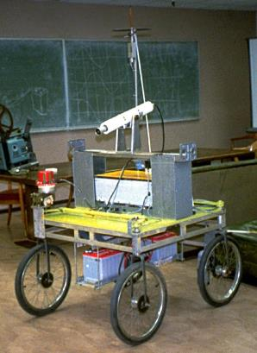
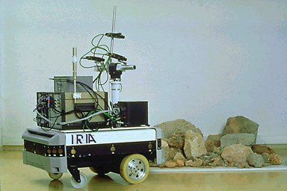
An Application: Mobile Robot Navigation
The INRIA Mobile Robot, 1990.
The Stanford Cart,
H. Moravec, 1979.
Courtesy O. Faugeras and H. Moravec.

Slide 5
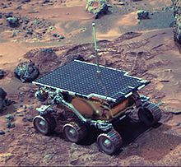
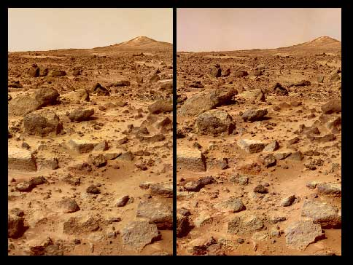
Stereo
NASA Mars Rover

Slide 6
6D Vision

Slide 7
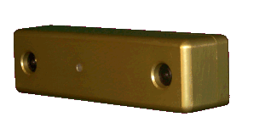
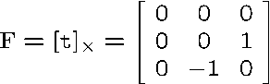
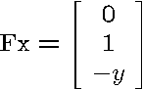
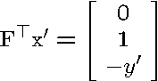
Standard stereo geometry
PointGrey Bumblebee
pure translation along X-axis

Slide 8
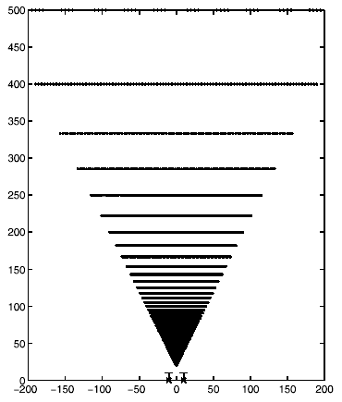
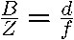
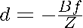
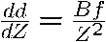
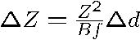
Standard stereo geometry

Slide 9
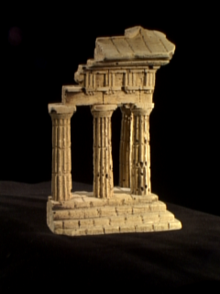
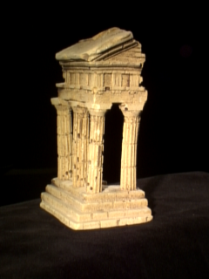
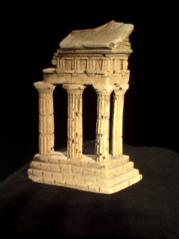
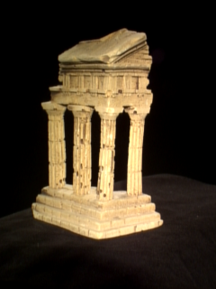
Stereo: basic idea
error
depth

Slide 10
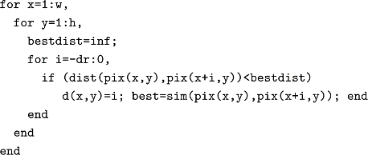
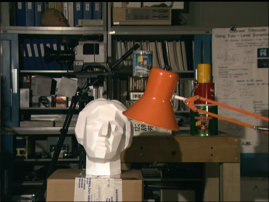
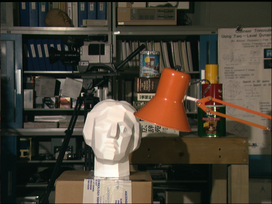
Stereo matching
Search is limited to epipolar line (1D)
Look for most similar pixel
?

Slide 11
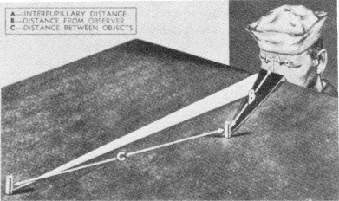
Stereopsis
Figure from US Navy Manual of Basic Optics and Optical Instruments, prepared by Bureau of
Naval Personnel. Reprinted by Dover Publications, Inc., 1969.

Slide 12
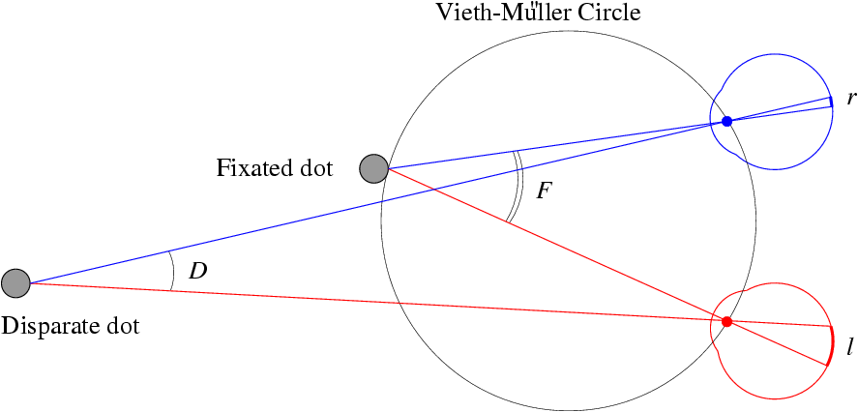
Human Stereopsis: Reconstruction
d=0
Disparity: d = r-l = D-F.
d<0
In 3D, the horopter.

Slide 13
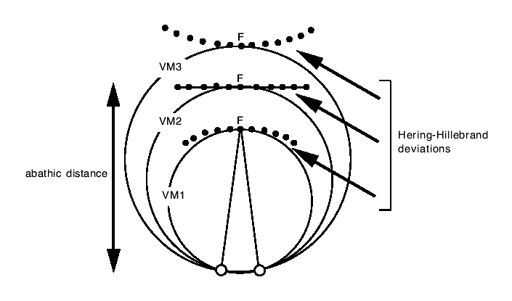
Human Stereopsis: experimental horopter…

Slide 14
Human Stereopsis: Reconstruction
What if F is not known?
Helmoltz (1909):
There is evidence showing the vergence angles
cannot be measured precisely.
Humans get fooled by bas-relief sculptures.
There is an analytical explanation for this.
Relative depth can be judged accurately.

Slide 15
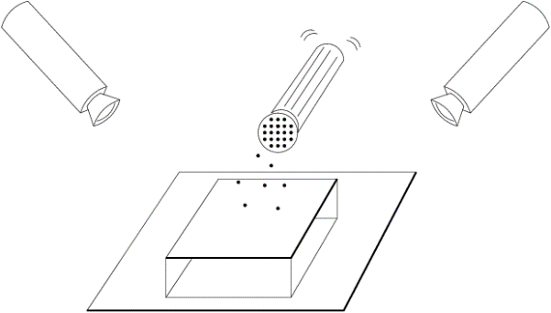
Human Stereopsis: Binocular Fusion
How are the correspondences established?
Julesz (1971): Is the mechanism for binocular fusion
a monocular process or a binocular one??
There is anecdotal evidence for the latter (camouflage).
Random dot stereograms provide an objective answer
BP!

Slide 16
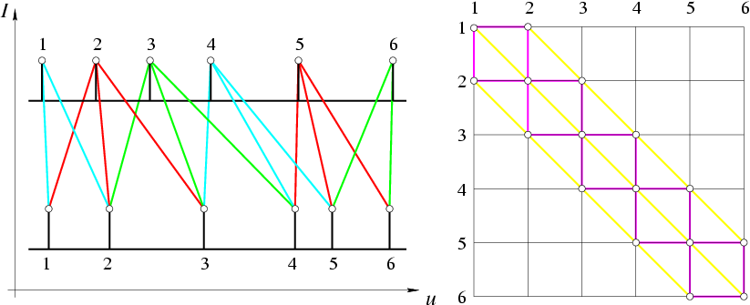
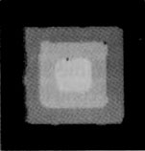
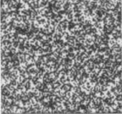
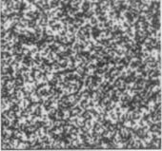
A Cooperative Model (Marr and Poggio, 1976)
Excitory connections: continuity
Inhibitory connections: uniqueness
Iterate: C = Σ C - wΣ C + C .
e
i
0
Reprinted from Vision: A Computational Investigation into the Human Representation and Processing of Visual Information by David Marr.
© 1982 by David Marr. Reprinted by permission of Henry Holt and Company, LLC.

Slide 17
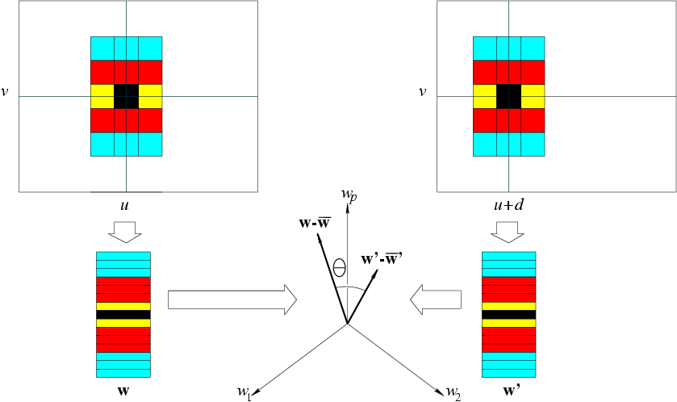
Correlation Methods (1970--)
Slide the window along the epipolar line until w.w’ is maximized.
2
Normalized Correlation: minimize θ instead.
Minimize |w-w’|.

Slide 18
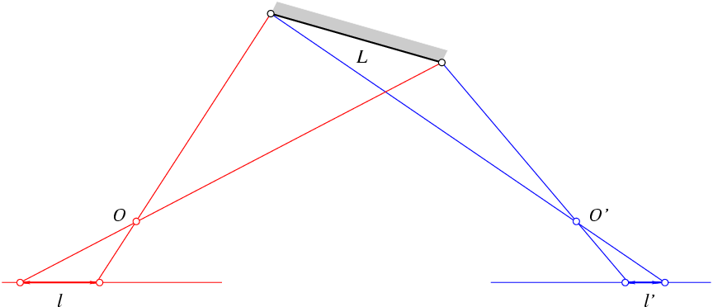
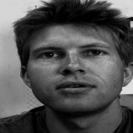
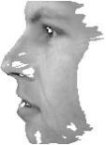
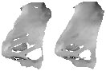

Correlation Methods: Foreshortening Problems
Solution: add a second pass using disparity estimates to warp
the correlation windows, e.g. Devernay and Faugeras (1994).
Reprinted from “Computing Differential Properties of 3D Shapes from Stereopsis without 3D Models,” by F. Devernay and O. Faugeras,
Proc. IEEE Conf. on Computer Vision and Pattern Recognition (1994). © 1994 IEEE.

Slide 19
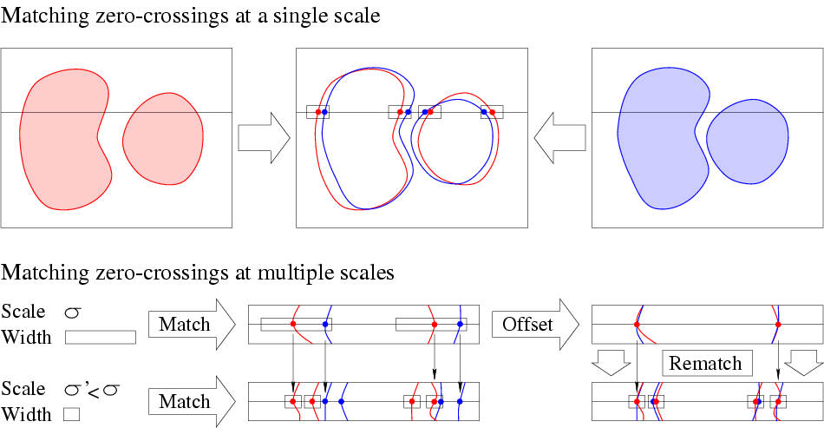
Multi-Scale Edge Matching (Marr, Poggio and Grimson, 1979-81)
Edges are found by repeatedly smoothing the image and detecting
the zero crossings of the second derivative (Laplacian).
Matches at coarse scales are used to offset the search for matches
at fine scales (equivalent to eye movements).

Slide 20
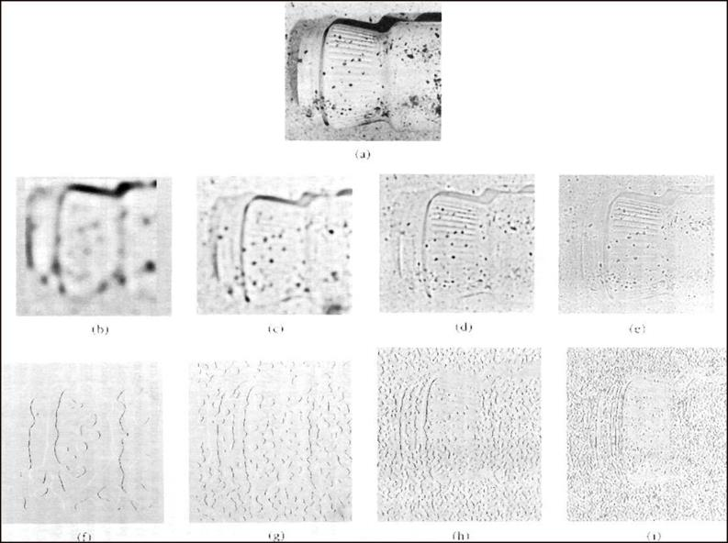
Multi-Scale Edge Matching (Marr, Poggio and Grimson, 1979-81)
One of the two
input images
Image Laplacian
Zeros of the Laplacian
Reprinted from Vision: A Computational Investigation into the Human Representation and Processing of Visual Information by David Marr.
© 1982 by David Marr. Reprinted by permission of Henry Holt and Company, LLC.

Slide 21
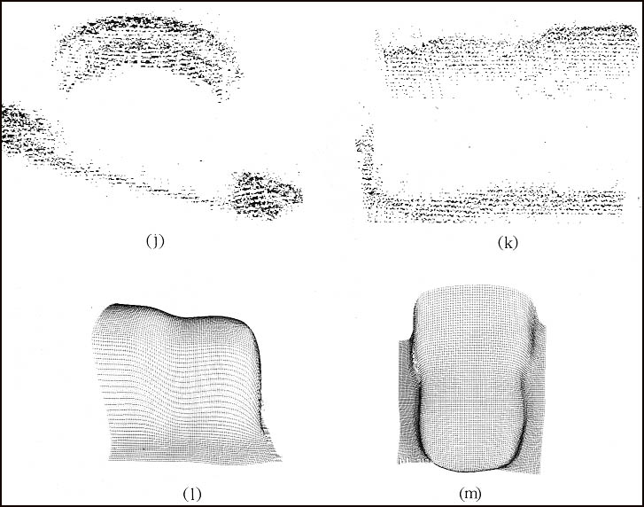
Multi-Scale Edge Matching (Marr, Poggio and Grimson, 1979-81)
Reprinted from Vision: A Computational Investigation into the Human Representation and Processing of Visual Information by David Marr.
© 1982 by David Marr. Reprinted by permission of Henry Holt and Company, LLC.

Slide 22
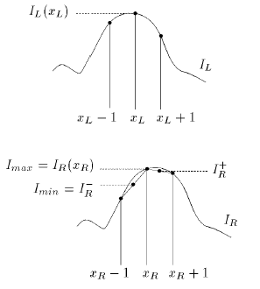
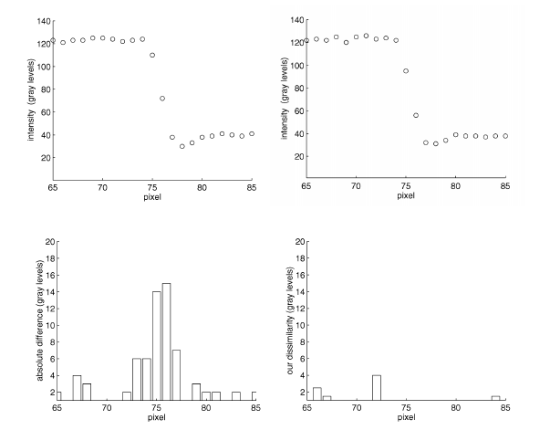
Pixel Dissimilarity
Absolute difference of intensities
c=|I1(x,y)- I2(x-d,y)|
Interval matching [Birchfield & Tomasi 98]
Considers sensor integration
Represents pixels as intervals

Slide 23
Alternative Dissimilarity Measures
Rank and Census transforms [Zabih ECCV94]
Rank transform:
Define window containing R pixels around each pixel
Count the number of pixels with lower intensities than center pixel in the window
Replace intensity with rank (0..R-1)
Compute SAD on rank-transformed images
Census transform:
Use bit string, defined by neighbors, instead of scalar rank
Robust against illumination changes

Slide 24
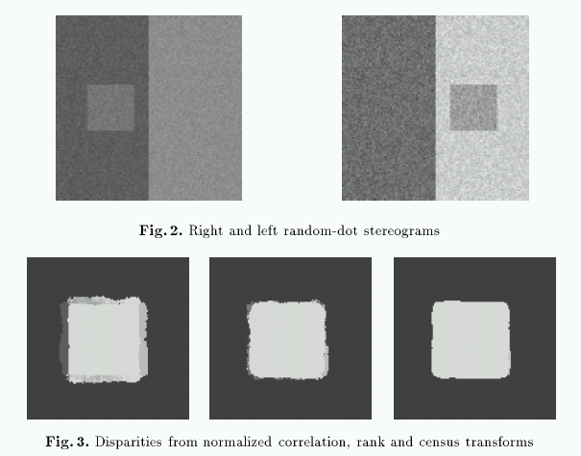
Rank and Census Transform Results
Noise free, random dot stereograms
Different gain and bias

Slide 25
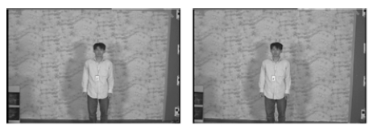
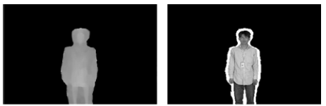
Systematic Errors of Area-based Stereo
Ambiguous matches in textureless regions
Surface over-extension [Okutomi IJCV02]

Slide 26
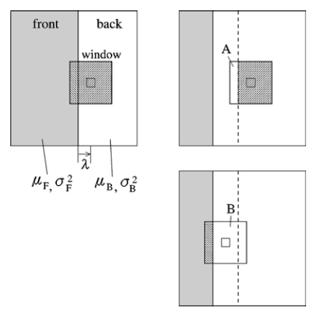
Surface Over-extension
Expected value of E[(x-y)²] for x in left and y in right image is:
Case A: σ_{F}²+ σ_{B}²+(μ_{F}- μ_{B})² for w/2-λ pixels in each row
Case B: 2 σ_{B}² for w/2+λ pixels in each row
Left image
Disparity of back surface
Right image

Slide 27
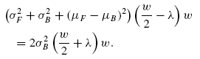
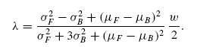
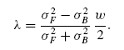
Surface Over-extension
Discontinuity perpendicular to epipolar lines
Discontinuity parallel to epipolar lines
Left image
Disparity of back surface
Right image

Slide 28
Over-extension and shrinkage
Turns out that: for discontinuities perpendicular to epipolar lines
And: for discontinuities parallel to epipolar lines

Slide 29
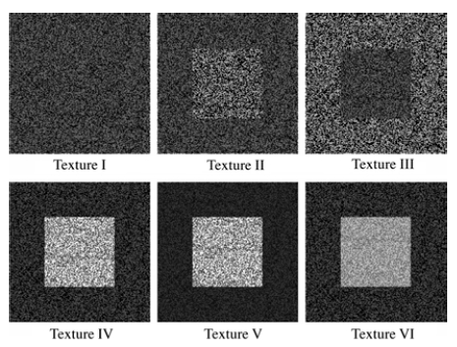
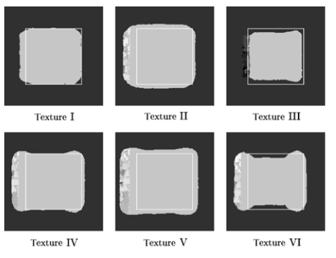
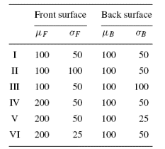
Random Dot Stereogram Experiments

Slide 30
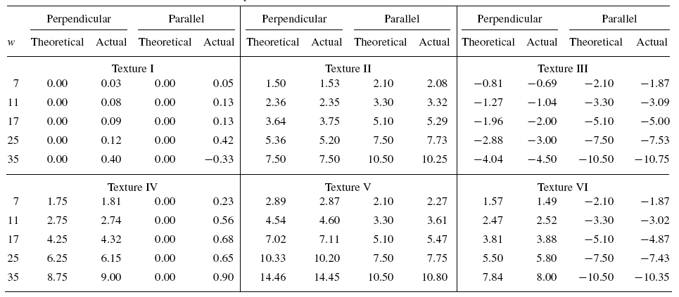
Random Dot Stereogram Experiments

Slide 31
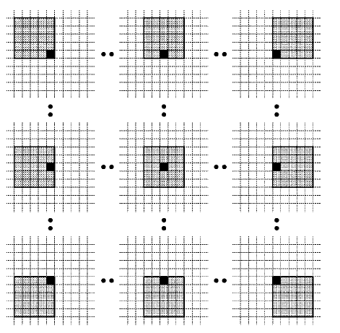

Offset Windows
Equivalent to using min nearby cost
Result: loss of depth accuracy

Slide 32

Discontinuity Detection
Use offset windows only where appropriate
Bi-modal distribution of SSD
Pixel of interest different than mode within window

Slide 33

Compact Windows
[Veksler CVPR03]: Adapt windows size based on:
Average matching error per pixel
Variance of matching error
Window size (to bias towards larger windows)
Pick window that minimizes cost

Slide 34
Integral Image
A
C
B
D
Shaded area = A+D-B-C Independent of size
Sum of shaded part
Compute an integral image for pixel dissimilarity at each possible disparity

Slide 35

Results using Compact Windows

Slide 36


Rod-shaped filters
Instead of square windows aggregate cost in rod-shaped shiftable windows [Kim CVPR05]
Search for one that minimizes the cost (assume that it is an iso-disparity curve)
Typically use 36 orientations

Slide 37

Locally Adaptive Support
Apply weights to contributions of neighboring pixels according to similarity and proximity [Yoon CVPR05]

Slide 38


Locally Adaptive Support
Similarity in CIE Lab color space:
Proximity: Euclidean distance
Weights:

Slide 39

Locally Adaptive Support: Results
Locally Adaptive Support

Slide 40

Locally Adaptive Support: Results

Slide 41

Cool ideas
Space-time stereo
(varying illumination, not shape)

Slide 42


Challenges
Ill-posed inverse problem
Recover 3-D structure from 2-D information
Difficulties
Uniform regions
Half-occluded pixels

Slide 43

Occlusions
(Slide from Pascal Fua)

Slide 44

Exploiting scene constraints

Slide 45

The Ordering Constraint
In general the points
are in the same order
on both epipolar lines.
But it is not always the case..

Slide 46
Ordering constraint
surface slice
surface as a path
6
5
occlusion left
4
1
2
3
4,5
6
1
2,3
4
5
6
2,3
occlusion right
1
1
2
3
4,5
6

Slide 47
Uniqueness constraint
In an image pair each pixel has at most one corresponding pixel
In general one corresponding pixel
In case of occlusion there is none

Slide 48
Disparity constraint
surface slice
surface as a path
bounding box
constant
disparity
surfaces
disparity band
use reconstructed features
to determine bounding box

Slide 49


Dynamic Programming (Baker and Binford, 1981)
Find the minimum-cost path going monotonically
down and right from the top-left corner of the
graph to its bottom-right corner.
Nodes = matched feature points (e.g., edge points).
Arcs = matched intervals along the epipolar lines.
Arc cost = discrepancy between intervals.

Slide 50

Stereo matching
Similarity measure
(SSD or NCC)
Constraints
epipolar
ordering
uniqueness
disparity limit
disparity gradient limit
Trade-off
Matching cost (data)
Discontinuities (prior)
Optimal path
(dynamic programming )
(Cox et al. CVGIP’96; Koch’96; Falkenhagen´97;
Van Meerbergen,Vergauwen,Pollefeys,VanGool IJCV‘02)

Slide 51



Dynamic Programming (Ohta and Kanade, 1985)
Reprinted from “Stereo by Intra- and Intet-Scanline Search,” by Y. Ohta and T. Kanade, IEEE Trans. on Pattern Analysis and Machine
Intelligence, 7(2):139-154 (1985). © 1985 IEEE.

Slide 52




Hierarchical stereo matching
Allows faster computation
Deals with large disparity ranges
Downsampling
(Gaussian pyramid)
Disparity propagation
(Falkenhagen´97;Van Meerbergen,Vergauwen,Pollefeys,VanGool IJCV‘02)

Slide 53

Disparity map
image I(x,y)
Disparity map D(x,y)
image I´(x´,y´)
(x´,y´)=(x+D(x,y),y)

Slide 54






Example: reconstruct image from neighboring images

Slide 55





Slide 56

Semi-global optimization
Optimize: E=E_{data}+E(|D_{p}-D_{q}|=1)+E(|D_{p}-D_{q}|>1) [Hirshmüller CVPR05]
Use mutual information as cost
NP-hard using graph cuts or belief propagation (2-D optimization)
Instead do dynamic programming along many directions
Don’t use visibility or ordering constraints
Enforce uniqueness
Add costs

Slide 57
Dynamic programming
data
cost
image scanline
0
0
0
0
0
0
0
0
0
1
1
1
1
1
1
1
1
1
disparity
levels
2
2
2
2
2
2
2
2
2
3
3
3
3
3
3
3
3
3
4
4
4
4
4
4
4
4
4
smoothness
cost
Step 1 path-cost propagation
Step 2 back-tracking best path

Slide 58
Dynamic programming
data
cost
image scanline
0
0
0
0
0
0
0
0
0
1
1
1
1
1
1
1
1
1
disparity
levels
2
2
2
2
2
2
2
2
2
3
3
3
3
3
3
3
3
3
4
4
4
4
4
4
4
4
4
smoothness
cost
Step 1 path-cost propagation
Step 2 back-tracking best path

Slide 59
Dynamic programming
data
cost
image scanline
0
0
0
0
0
0
0
0
0
1
1
1
1
1
1
1
1
1
disparity
levels
cheapest
path cost
2
2
2
2
2
2
2
2
2
3
3
3
3
3
3
3
3
3
4
4
4
4
4
4
4
4
4
smoothness
cost
Step 1 path-cost propagation
Step 2 back-tracking best path

Slide 60
Semi-Global Matching
data
cost
image scanline
0
0
0
0
0
1
1
1
1
1
cheapest
path costs
(until here)
disparity
levels
2
2
2
2
2
3
3
3
3
3
4
4
4
4
4
smoothness
cost
0
0
0
0
0
cheapest
path costs
(until here)
1
1
1
1
1
2
2
2
2
2
3
3
3
3
3
4
4
4
4
4
Step 1 path-cost propagation
Step 2 path-cost propagation
Step 3 path-cost propagation
...
Step N+1 sum up costs for total tree cost
guarantees optimal solution
for combined path
(BUT other pixels have different paths)

Slide 61


Results of Semi-global optimization

Slide 62


Results of Semi-global optimization
No. 1 overall in Middlebury evaluation (at 0.5 error threshold as of Sep. 2006)

Slide 63

Energy minimization
(Slide from Pascal Fua)

Slide 64

Graph Cut
(general formulation requires multi-way cut!)
(Slide from Pascal Fua)

Slide 65


Simplified graph cut
(Roy and Cox ICCV‘98)
(Boykov et al ICCV‘99)

Slide 66



Belief Propagation
Belief of one node about another gets propagated through messages (full pdf, not just most likely state)
first iteration
per pixel
+left
+right
+up
+down
subsequent iterations
2
3
4
5
...
20
(adapted from J. Coughlan slides)

Slide 67




Slide 68

Rectification
All epipolar lines are parallel in the rectified image plane.

Slide 69
Image pair rectification
simplify stereo matching
by warping the images
Apply projective transformation so that epipolar lines
correspond to horizontal scanlines
e
e
map epipole e to (1,0,0)
try to minimize image distortion
problem when epipole in (or close to) the image

Slide 70
Planar rectification
(standard approach)
~ image size
(calibrated)
Bring two views
to standard stereo setup
(moves epipole to ∞)
(not possible when in/close to image)
Distortion minimization
(uncalibrated)

Slide 71





Slide 72





Slide 73

Polar rectification
(Pollefeys et al. ICCV’99)
Polar re-parameterization around epipoles
Requires only (oriented) epipolar geometry
Preserve length of epipolar lines
Choose Δθ so that no pixels are compressed
original image
rectified image
Works for all relative motions
Guarantees minimal image size

Slide 74


polar rectification: example

Slide 75


polar rectification: example

Slide 76




Example: Béguinage of Leuven
Does not work with standard
Homography-based approaches

Slide 77



Example: Béguinage of Leuven

Slide 78

Reconstruction from Rectified Images
Disparity: d=u’-u.
Depth: z = -B/d.

Slide 79

Three Views
The third eye can be used for verification..

Slide 80
Choosing the stereo baseline
all of these
points project
to the same
pair of pixels
width of
a pixel
Large Baseline
Small Baseline
What’s the optimal baseline?
Too small: large depth error
Too large: difficult search problem, more occlusions

Slide 81


The Effect of Baseline on Depth Estimation
(Okutami and Kanade PAMI’93)

Slide 82




Slide 83




I1
I2
I10
Reprinted from “A Multiple-Baseline Stereo System,” by M. Okutami and T. Kanade, IEEE Trans. on Pattern
Analysis and Machine Intelligence, 15(4):353-363 (1993). \copyright 1993 IEEE.

Slide 84
Problem: visibility
Some Solutions
Multi-view linking (Koch et al. ECCV98)
Best of left or right (Kang et al. CVPR01)
Best k out of n , ...

Slide 85

Variable Baseline/Resolution Stereo
(Gallup et al., CVPR08)
Multi-baseline, multi-resolution
At each depth, baseline and resolution selected proportional to that depth
Allows to keep depth accuracy constant!

Slide 86









Variable Baseline/Resolution Stereo: comparison

Slide 87


Multi-view depth fusion
(Koch, Pollefeys and Van Gool. ECCV‘98)
Compute depth for every pixel of reference image
Triangulation
Use multiple views
Up- and down sequence
Use Kalman filter
Allows to compute robust texture

Slide 88


Slide 89

Combine multiple aggregation windows using hardware mipmap and multiple texture units in single pass
(1x1)
(1x1+2x2
+4x4+8x8)
(1x1+2x2
+4x4+8x8
+16x16)
(1x1+2x2)

Slide 90

Plane-sweep multi-view matching
Simple algorithm for multiple cameras
no rectification necessary
doesn’t deal with occlusions
Collins’96; Roy and Cox’98 (GC); Yang et al.’02/’03 (GPU)

Slide 91



Fast GPU-based plane-sweeping stereo
Plane-sweep multi-view depth estimation
(Yang & Pollefeys, CVPR’03)
Notes:
One of the constraints to estimate depth from multiple images is photo-consistency. This constraints expresses the fact that pixels that correspond to a point on the true object surface should have a consistent appearance, i.e. in general have the same color. A simple and efficient approach to compute depth based on this principle is the plane-sweep approach. The approach consist of sweeping a plane through the volume under consideration. For each location of the plane, all the images are projected on the plane and the algorithm verifies how similar pixels projected from different images are. Along rays corresponding to pixel of a reference view, the best match is chosen as the depth estimate for that pixel.
In the slide an example is shown that corresponds to a virtual thea pot in front of a canvas. On the top-right the images corresponding to the four cameras are blended together, on the bottom-right the corresponding sum-of-absolute-differences between RGB values is shown. Black corresponds to a perfect match.

Slide 92

Plane Sweep Stereo
Images Projected on Plane
Plane Sweep
Matching Score

Slide 93


Plane Sweep Stereo Result
Ideal for GPU processing
512x384 depthmap, 50 planes, 5 images: 50 Hz

Slide 94



Plane Sweep Stereo
Images Projected on Plane
Plane Sweep
Matching Score (SAD)

Slide 95


Window-Based Matching - Local Stereo
Pixel-to-pixel matching is ambiguous for local stereo
Use a matching window (SAD/SSD/NCC)
Assumes all pixels in window are on the plane

Slide 96



Multi-directional plane-sweeping stereo
(Gallup, Frahm & Pollefeys, CVPR07)
Select best-cost over depths AND orientation
3D model from
11 video frames
(hand-held)
Automatic computations of dominant orientations

Slide 97




Plane Priors and Quicksweep
Use SfM points as a prior for stereo
without plane prior
with plane prior
For real-time:
test only the planes with high prior probability

Slide 98






Selecting Best Depth / Surface Normal
Combining multiple sweeps
Sweep 1
Sweep 2
Sweep 3
How to combine sweeps?
Graph Cut:
1-2 seconds
Continuous Formulation: 45 ms
OR
Local best cost
Global labeling
(Zach, Gallup, Frahm,
Niethammer VMV 2008)
Notes:
fix sweep images

Slide 99




Results
1474 frame reconstruction, 11 images in stereo,
512x384 grayscale, 48 plane hypotheses (quick sweep), processing rate 20.0 Hz (Nvidia 8800 GTX)

Slide 100

Another Scene
view 1
. . .
. . .
view N

Slide 101




Depthmap
view 1
. . .
reference
view
. . .
view N

Slide 102

3D Model: Standard Stereo

Slide 103

3D Model: Standard Stereo

Slide 104

3D Model: Standard Stereo

Slide 105

3D Model: Standard Stereo

Slide 106
How Accurate Is Stereo?
b = baseline
f = focal length
d = disparity
z = depth
Δz
z
Δd
d
f
b
Notes:
Add legend with words: baseline, focal length, etc.

Slide 107
Variable Baseline/Resolution Stereo
(Gallup et al., CVPR08)
Multi-baseline, multi-resolution
At each depth, baseline and resolution selected proportional to that depth
Allows to keep depth accuracy constant!

Slide 108
Verification of consistent results
Analysis of matching scores at various baselines and scales
Location of global minimum unchanged
Value of global minimum preserved

Slide 109
Variable Baseline/Resolution Stereo: comparison

Slide 110

Results
Notes:
Make sure it also has the depth resolution at the end

Slide 111

Depth Resolution Limits

Slide 112




Piecewise Planar Stereo
Fit planes to scene
But also handle non-planar regions
Use planar appearance
Ensure consistency over video sequences

Slide 113


3D Reconstruction from Video
Street-Side Video
Real-Time Stereo

Slide 114

Heightmap Model
(Gallup et al. 3DPVT 2010)
Enforces vertical facades
One continuous surface, no holes
2.5D: Fast to compute, easy to store

Slide 115

Occupancy Voting
voxel
d
depth
voxel
This is a
log-odds
likelihood
camera

Slide 116
n-layer heightmap fusion
(Gallup et al. DAGM’10)
Generalize to n-layer heightmap
Each layer is a transition from full/empty or empty/full
Compute layer positions with dynamic programming
Use model selection (BIC) to determine number of layers

Slide 117


n-layer heightmap fusion

Slide 118








Reconstruction from Photo Collections
Millions of images download from Flickr
Camera poses computed using (Li et al. ECCV’08)
Depthmaps from GPU planesweep

Slide 119

Results

Slide 120

Other Approaches
Level-Set Methods [Faugeras & Keriven 1998]
Evolve implicit function by solving PDE’s
More recent level-set/PDE approaches by Pons et al., CVPR05, Gargallo et al. ICCV07, Kalin and Kremers ECCV08, …

Slide 121
Volumetric Graph cuts
1. Outer surface
2. Inner surface (at constant offset)
3. Discretize middle volume
ρ(x)
4. Assign photoconsistency cost to voxels
Slides from [Vogiatzis et al. CVPR2005]

Slide 122
Volumetric Graph cuts
Source
Sink
Slides from [Vogiatzis et al. CVPR2005]

Slide 123
Volumetric Graph cuts
cut ⇔ 3D Surface S
Cost of a cut ≈ ∫∫ ρ(x) dS
Source
S
[Boykov and Kolmogorov ICCV 2001]
S
Sink
Slides from [Vogiatzis et al. CVPR2005]

Slide 124
Volumetric Graph cuts
Minimum cut ⇔ Minimal 3D Surface under photo-consistency metric
Source
[Boykov and Kolmogorov ICCV 2001]
Sink
Slides from [Vogiatzis et al. CVPR2005]

Slide 125
Photo-consistency
Occlusion
1. Get nearest point on outer surface
2. Use outer surface for occlusions
2. Discard occluded views
Slides from [Vogiatzis et al. CVPR2005]

Slide 126
Photo-consistency
Occlusion
Self occlusion
Slides from [Vogiatzis et al. CVPR2005]

Slide 127
Photo-consistency
Occlusion
Self occlusion
Slides from [Vogiatzis et al. CVPR2005]

Slide 128
Photo-consistency
Occlusion
threshold on angle between normal and viewing direction
threshold= ~60°
N
Slides from [Vogiatzis et al. CVPR2005]

Slide 129
Photo-consistency
Normalised cross correlation
Use all remaining cameras pair wise
Average all NCC scores
Score
Slides from [Vogiatzis et al. CVPR2005]

Slide 130
Photo-consistency
Average NCC = C
Voxel score
ρ = 1 - exp( -tan²[π(C-1)/4] / σ² )
Score
0 ≤ ρ ≤ 1
σ = 0.05 in all experiments
Slides from [Vogiatzis et al. CVPR2005]

Slide 131

Example
Slides from [Vogiatzis et al. CVPR2005]

Slide 132

Example - Visual Hull
Slides from [Vogiatzis et al. CVPR2005]

Slide 133

Example - Slice
Slides from [Vogiatzis et al. CVPR2005]

Slide 134

Protrusion problem
‘Balooning’ force
favouring bigger volumes that fill the visual hull
L.D. Cohen and I. Cohen. Finite-element methods for active contour models and balloons for 2-d and 3-d images. PAMI, 15(11):1131–1147, November 1993.
Slides from [Vogiatzis et al. CVPR2005]

Slide 135
Protrusion problem
∫∫ ρ(x) dS - λ ∫∫∫ dV
S
V
‘Balooning’ force
favouring bigger volumes that fill the visual hull
L.D. Cohen and I. Cohen. Finite-element methods for active contour models and balloons for 2-d and 3-d images. PAMI, 15(11):1131–1147, November 1993.
Slides from [Vogiatzis et al. CVPR2005]

Slide 136





Protrusion problem
Slides from [Vogiatzis et al. CVPR2005]

Slide 137


Protrusion problem
Slides from [Vogiatzis et al. CVPR2005]

Slide 138
Graph
SOURCE
w_{ij} = 4/3πh² * (ρ_{i}+ρ_{j})/2
[Boykov and Kolmogorov ICCV 2001]
w_{b}
w_{b} = λh³
w_{b}
w_{ij}
i
j
h
Slides from [Vogiatzis et al. CVPR2005]

Slide 139



Graph-cut on Dual of Adaptive Tetrahedral Mesh
(Sinha et. al. 2007)
Address Memory and Computational Overhead
Compute Photo-consistency only where it is needed
Detect Interior Pockets using Visibility
Notes:
We have extended their approach to work with an adaptive semi-regular tetrahedral mesh.
Our tetrahedral mesh is densely tessellated in the regions which are likely to contain some surface element.
A key contribution is that we show how to do this without computing photo-consistency everywhere in the volume.
We also automatically detect pockets and free-space based on the visibility of sparse surface patches.

Slide 140
Adaptive Mesh Refinement
Cell (Tetrahedron)
Unknown surface
Face (triangle)
Notes:
Here is the idea behind our adaptive mesh refinement.
We start with a coarse tetrahedral mesh.

Slide 141
Adaptive Mesh Refinement
Detect crossing faces
by testing photo-consistency
of points sampled on the faces
Notes:
We densely sample the faces embedded within the tetrahedral mesh checking for photo-consistent points.
The ones that cross the unknown surface will show some evidence. These are in blue.

Slide 142
Adaptive Mesh Refinement
If none of the faces of a cell are crossing faces,
that cell cannot any surface element.
Notes:
If all four faces of a tetrahedron are red, then there is no point sampling inside it because it cannot contain any piece
Of the surface.

Slide 143
Adaptive Mesh Refinement
Prune the Inactive cells
Refine the Active cells
Notes:
So we prune away all the red cells and subdivide and refine the blue ones until we reach a suitable resolution.

Slide 144


Mesh with Photo-consistency
Final Mesh shown with
Photo-consistency
144
Notes:
144
In the next iteration the blue band is further subdivided.

Slide 145

Detect Interior
Use Visibility of the
Photo-consistent Patches
Also proposed by
Hernandez et. al. 2007, Labatut et. al. 2007
145
Notes:
145
In the next iteration the blue band is further subdivided.

Slide 146

First Graph-Cut
Compute the Min-cut
Source
Sink
Solution re-projected into
the original silhouette
146
Notes:
146
In the next iteration the blue band is further subdivided.

Slide 147
Silhouette Constraints
Every such ray must meet the
real surface at least once
147
Notes:
147
In the next iteration the blue band is further subdivided.

Slide 148
Silhouette Constraints
Photo-consistency
Surface
Test photo-consistency
along the ray
Robustly find an interior cell
148
Notes:
148
In the next iteration the blue band is further subdivided.

Slide 149
Final Graph-Cut
Source
Sink
149
Notes:
149
In the next iteration the blue band is further subdivided.

Slide 150

Final Graph-Cut
Before After
150
Notes:
150
In the next iteration the blue band is further subdivided.

Slide 151

Results
After graph-cut optimization
36 images
2000 x 3000 pixels
Notes:
The graph-cut does not recover a lot of surface detail –
we do a subsequent local refinement by sub-dividing the surface mesh and perturbing the vertices locally to optimize photo-consistency.

Slide 152

20 images
640 x 480 pixels
20 images
Running Time:
Graph Construction : 25 mins
Graph-cut : 5 mins
Local Refinement : 20 mins
Notes:
152
More results

Slide 153



36 images
36 images
Notes:
Results – describe how we allow topology changes.

Slide 154


24 images
48 images
47 images
154
Notes:
154
More results

Slide 155


Photo-consistency + silhouettes
[Sinha and Pollefeys ICCV05]
Optimize photo-consistency while exactly enforcing silhouette constraint

Slide 156




Interesting comparison of multi-view stereo approaches
http://vision.middlebury.edu/mview/

Slide 157
Dense Multi-View Stereo Benchmark
More realistic scenes scanned with laser scanner
https://www.eth3d.net/
https://www.tanksandtemples.org/

Slide 158
Deep Stereo Matching

Slide 159

Deep Stereo reconstruction
In 2015 Zbontar and LeCun[1] propose first approach to deep stereo matching
Train a model to classify patches in similar or not similar
Build cost volume and apply standard SGM
[1] J. Zbontar and Y. LeCun. "Computing the stereo matching cost with a convolutional neural network." CVPR ‘15

Slide 160


Deep Stereo reconstruction
Dataset for training constructed from KITTI and Middlebury
Patches extracted from true disparity have low cost, otherwise high cost
Two network architecture proposed:
Fast:
Accurate:
Siamese network with tied convolutional weights + Dot product
Separate feature extraction branches concatenated and passed to fully connected layers

Slide 161

Deep Stereo reconstruction
In 2017 Seki and Pollefeys[1] use neural network to predict disparity penalties of SGM algorithm
P1: slanted surface penalty
P2: discontinuous penalty
[1] A. Seki and M. Pollefeys. "SGM-Nets: Semi-global matching with neural networks." CVPR ‘17

Slide 162

Deep Stereo reconstruction
In 2017 Kendall at al. [1] propose the very first end-to-end network:
Main contributions:
End-to-End: images in, disparity out (regression)
Made popular softargmin operation (Differentiable argmin)
Use 3d convolution to regularize cost volume
[1] A. Kendall, et al. End-to-end learning of geometry and context for deep stereo regression. ICCV 2017. S. 66-75.

Slide 163

Analysis of a deep stereo network
All networks mimic a classic stereo pipeline[1]:
Pros:
End-to-End networks are fast and accurate on scenes seen at test time (Kitti [2])
Cons:
Hard to generalize (top on KITTI[2] , on middlebury stereo[3] they struggle)
[1] Scharstein, D., Szeliski, R. (2002). A taxonomy and evaluation of dense two-frame stereo correspondence algorithms, IJCV
[2] http://www.cvlibs.net/datasets/kitti/eval_scene_flow.php?benchmark=stereo
[3] http://vision.middlebury.edu/stereo/eval3/

Slide 164

Deep Multi-View Stereo network
Yao et al. in 2018 propose the very first learning based Multi-View Stereo network
Input images can’t be rectified as in stereo:
How to encode the camera information inside the network? Plane Sweeping on front parallel plane
Refinement
Multiple inputs
Feature extraction
Image warping
Matching
Filtering and regularization
Yao, Y., Luo, Z., Li, S., Fang, T., & Quan, L. MVSNet: Depth Inference for Unstructured Multi-view Stereo. ECCV18
Depth extraction with Softmax

Slide 165
Deep Multi-View Stereo network
Redundant images make deep MVS generalize better than pure stereo:
State-of-the art result on eth3d[1] and tanks and temples[2] benchmarks
Open issues:
memory consumption
Image size used for training/testing
Fronto parallel bias
[1] https://www.eth3d.net/high_res_multi_view
https://www.tanksandtemples.org/leaderboard/

Slide 166

Space Carving

Slide 167
3D Reconstruction from Calibrated Images
Scene Volume
V
Input Images
(Calibrated)
Goal: Determine transparency, radiance of points in V

Slide 168
Discrete Formulation: Voxel Coloring
Discretized
Scene Volume
Input Images
(Calibrated)
Goal: Assign RGBA values to voxels in V
photo-consistent with images

Slide 169
Complexity and Computability
Discretized
Scene Volume
3
N voxels
C colors
True
Scene
All Scenes (C^{N3})
Photo-Consistent
Scenes

Slide 170
Issues
Theoretical Questions
Identify class of all photo-consistent scenes
Practical Questions
How do we compute photo-consistent models?

Slide 171
Voxel Coloring Solutions
1. C=2 (silhouettes)
Volume intersection [Martin 81, Szeliski 93]
2. C unconstrained, viewpoint constraints
Voxel coloring algorithm [Seitz & Dyer 97]
3. General Case
Space carving [Kutulakos & Seitz 98]

Slide 172
Reconstruction from Silhouettes (C = 2)
Binary Images
Approach:
Backproject each silhouette
Intersect backprojected volumes

Slide 173
Volume Intersection
Reconstruction Contains the True Scene
But is generally not the same
In the limit get visual hull
Complement of all lines that don’t intersect S

Slide 174
Voxel Algorithm for Volume Intersection
Color voxel black if on silhouette in every image
O(MN³), for M images, N³ voxels
Don’t have to search 2^{N3} possible scenes!

Slide 175
Properties of Volume Intersection
Pros
Easy to implement, fast
Accelerated via octrees [Szeliski 1993]
Cons
No concavities
Reconstruction is not photo-consistent
Requires identification of silhouettes

Slide 176
Voxel Coloring Solutions
1. C=2 (silhouettes)
Volume intersection [Martin 81, Szeliski 93]
2. C unconstrained, viewpoint constraints
Voxel coloring algorithm [Seitz & Dyer 97]
3. General Case
Space carving [Kutulakos & Seitz 98]

Slide 177
Voxel Coloring Approach
1. Choose voxel
2. Project and correlate
3. Color if consistent
Visibility Problem: in which images is each voxel visible?

Slide 178
The Global Visibility Problem
Which points are visible in which images?
Known Scene
Unknown Scene
Forward Visibility
known scene
Inverse Visibility
known images

Slide 179
Depth Ordering: visit occluders first!
Layers
Scene
Traversal
Condition: depth order is view-independent

Slide 180
Panoramic Depth Ordering
Cameras oriented in many different directions
Planar depth ordering does not apply

Slide 181
Panoramic Depth Ordering
Layers radiate outwards from cameras

Slide 182
Panoramic Layering
Layers radiate outwards from cameras

Slide 183
Panoramic Layering
Layers radiate outwards from cameras

Slide 184


Compatible Camera Configurations
Depth-Order Constraint
Scene outside convex hull of camera centers
Inward-Looking
cameras above scene
Outward-Looking
cameras inside scene

Slide 185





Calibrated Image Acquisition
Selected Dinosaur Images
Calibrated Turntable
360° rotation (21 images)
Selected Flower Images

Slide 186


Voxel Coloring Results (Video)
Dinosaur Reconstruction
72 K voxels colored
7.6 M voxels tested
7 min. to compute
on a 250MHz SGI
Flower Reconstruction
70 K voxels colored
7.6 M voxels tested
7 min. to compute
on a 250MHz SGI

Slide 187
Limitations of Depth Ordering
A view-independent depth order may not exist
p
q
Need more powerful general-case algorithms
Unconstrained camera positions
Unconstrained scene geometry/topology

Slide 188
Voxel Coloring Solutions
1. C=2 (silhouettes)
Volume intersection [Martin 81, Szeliski 93]
2. C unconstrained, viewpoint constraints
Voxel coloring algorithm [Seitz & Dyer 97]
3. General Case
Space carving [Kutulakos & Seitz 98]

Slide 189
Space Carving Algorithm
Image 1
Image N
…...
Space Carving Algorithm
Initialize to a volume V containing the true scene
Choose a voxel on the current surface
Project to visible input images
Carve if not photo-consistent
Repeat until convergence

Slide 190
Convergence
Consistency Property
The resulting shape is photo-consistent
all inconsistent points are removed
Convergence Property
Carving converges to a non-empty shape
a point on the true scene is never removed
p
V’
V

Slide 191


What is Computable?
V
V
True Scene
Photo Hull
The Photo Hull is the UNION of all photo-consistent scenes in V
It is a photo-consistent scene reconstruction
Tightest possible bound on the true scene
Computable via provable Space Carving Algorithm

Slide 192
Space Carving Algorithm
The Basic Algorithm is Unwieldy
Complex update procedure
Alternative: Multi-Pass Plane Sweep
Efficient, can use texture-mapping hardware
Converges quickly in practice
Easy to implement

Slide 193
Space Carving Algorithm
Step 1: Initialize V to volume containing true scene
Step 2: For every voxel on surface of V
test photo-consistency of voxel
if voxel is inconsistent, carve it
Step 3: Repeat Step 2 until all voxels consistent
Convergence:
Always converges to a photo-consistent model
(when all assumptions are met)
Good results on difficult real-world scenes

Slide 194

Multi-Pass Plane Sweep
Sweep plane in each of 6 principle directions
Consider cameras on only one side of plane
Repeat until convergence
True Scene
Reconstruction

Slide 195
Multi-Pass Plane Sweep
Sweep plane in each of 6 principle directions
Consider cameras on only one side of plane
Repeat until convergence

Slide 196
Multi-Pass Plane Sweep
Sweep plane in each of 6 principle directions
Consider cameras on only one side of plane
Repeat until convergence

Slide 197
Multi-Pass Plane Sweep
Sweep plane in each of 6 principle directions
Consider cameras on only one side of plane
Repeat until convergence

Slide 198
Multi-Pass Plane Sweep
Sweep plane in each of 6 principle directions
Consider cameras on only one side of plane
Repeat until convergence

Slide 199
Multi-Pass Plane Sweep
Sweep plane in each of 6 principle directions
Consider cameras on only one side of plane
Repeat until convergence

Slide 200
Multi-Pass Plane Sweep
Sweep plane in each of 6 principle directions
Consider cameras on only one side of plane
Repeat until convergence

Slide 201
Multi-Pass Plane Sweep
Sweep plane in each of 6 principle directions
Consider cameras on only one side of plane
Repeat until convergence

Slide 202
Multi-Pass Plane Sweep
Sweep plane in each of 6 principle directions
Consider cameras on only one side of plane
Repeat until convergence

Slide 203
Multi-Pass Plane Sweep
Sweep plane in each of 6 principle directions
Consider cameras on only one side of plane
Repeat until convergence

Slide 204
Multi-Pass Plane Sweep
Sweep plane in each of 6 principle directions
Consider cameras on only one side of plane
Repeat until convergence

Slide 205
Multi-Pass Plane Sweep
Sweep plane in each of 6 principle directions
Consider cameras on only one side of plane
Repeat until convergence

Slide 206
Multi-Pass Plane Sweep
Sweep plane in each of 6 principle directions
Consider cameras on only one side of plane
Repeat until convergence

Slide 207
Multi-Pass Plane Sweep
Sweep plane in each of 6 principle directions
Consider cameras on only one side of plane
Repeat until convergence

Slide 208
Multi-Pass Plane Sweep
Sweep plane in each of 6 principle directions
Consider cameras on only one side of plane
Repeat until convergence

Slide 209
Multi-Pass Plane Sweep
Sweep plane in each of 6 principle directions
Consider cameras on only one side of plane
Repeat until convergence

Slide 210
Multi-Pass Plane Sweep
Sweep plane in each of 6 principle directions
Consider cameras on only one side of plane
Repeat until convergence

Slide 211
Multi-Pass Plane Sweep
Sweep plane in each of 6 principle directions
Consider cameras on only one side of plane
Repeat until convergence

Slide 212
Multi-Pass Plane Sweep
Sweep plane in each of 6 principle directions
Consider cameras on only one side of plane
Repeat until convergence

Slide 213
Multi-Pass Plane Sweep
Sweep plane in each of 6 principle directions
Consider cameras on only one side of plane
Repeat until convergence

Slide 214
Multi-Pass Plane Sweep
Sweep plane in each of 6 principle directions
Consider cameras on only one side of plane
Repeat until convergence

Slide 215
Multi-Pass Plane Sweep
Sweep plane in each of 6 principle directions
Consider cameras on only one side of plane
Repeat until convergence

Slide 216




Space Carving Results: African Violet
Input Image (1 of 45)
Reconstruction
Reconstruction
Reconstruction

Slide 217



Space Carving Results: Hand
Input Image
(1 of 100)
Views of Reconstruction

Slide 218
Other Features
Coarse-to-fine Reconstruction
Represent scene as octree
Reconstruct low-res model first, then refine
Hardware-Acceleration
Use texture-mapping to compute voxel projections
Process voxels an entire plane at a time
Limitations
Need to acquire calibrated images
Restriction to simple radiance models
Bias toward maximal (fat) reconstructions
Transparency not supported

Slide 219


Slide 220



Probalistic Space Carving
Broadhurst et al. ICCV’01
voxel occluded

Slide 221







The Master's Lodge Image Sequence
Bayesian

Slide 222

Space carving for specular surfaces
(Yang, Pollefeys and Welch 2003)
Notes:
Research in photogeometry has shown that reflected light can be decomposed into the sum of two terms, a diffuse term, which depends on the light intensity, object color, surface normal, and light direction. And a specular terms. For dielectric materails, the specular term can be written as the product of the light intensity and a function of the view vector and the reflection vector.
For a given surface point under one fixed light, if we collect and plot the reflected lights from all viewing angles in the RGB color space, we are expected to see a line. The starting point corresponds to the diffuse term. The line is pointing to the direction of line. If we take into account the limit dynamic range of cameras, then we will see three line segments, one color channel first saturates, then the second, eventaully all saturated, and converge to white.

Slide 223




Experiment
Notes:
Here is another experiments.

Slide 224

Animated Views
Our result
Notes:
Here are the reconstructed views

Slide 225


Semantic Multi-View Stereo Fusion
minimize Δ
proper treatment of visibility
inference
generative
(prior)
(datacost)
(Savinov et al, CVPR15/16)

Slide 226
Next week: Structure from Motion

